Slide 1

CREDIT CARDS
ML
MACHINE LEARNING
CLASSIFICATION OF CREDIT CARD ACCEPTANCE

Slide 2
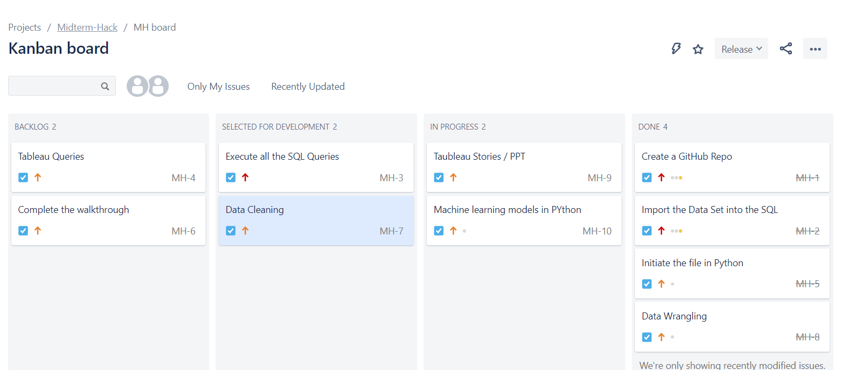

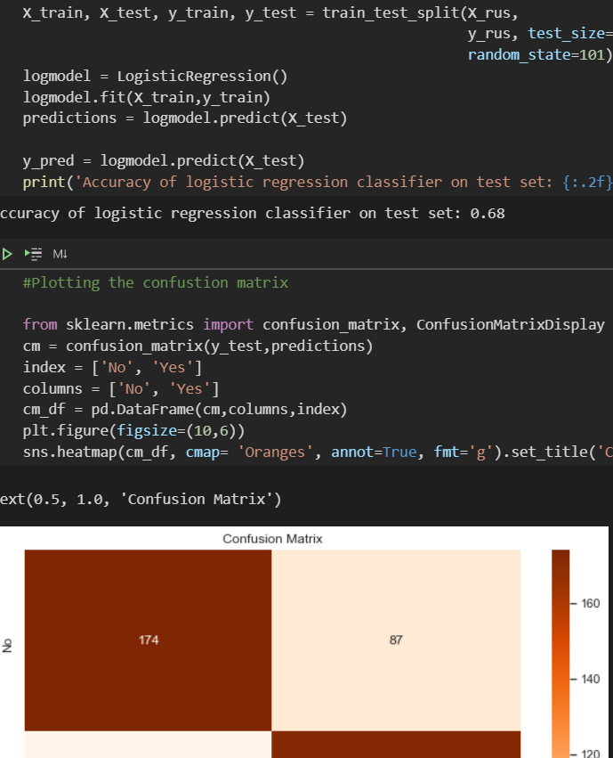
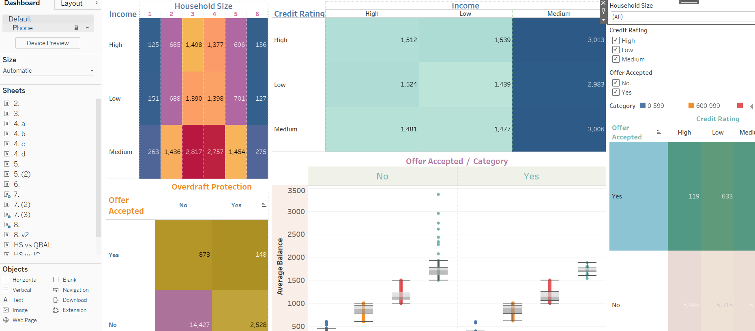
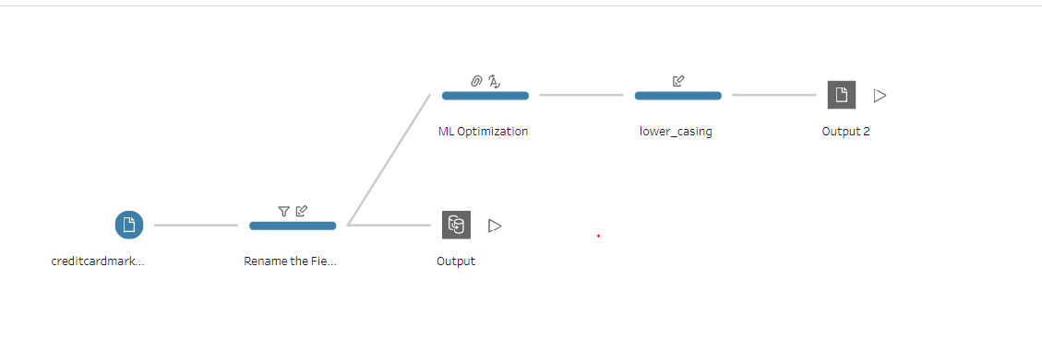
Tools Used
JIRA - Project Management using Agile techniques
Jupyter Notebook- Python based Data Wrangling and Machine Learning
Tableau - Data Visualization and Dashboards
Tableau Prep - Data Cleaning and preparation
PowerPoint - Presentation
GitHub Desktop - Committing and Updating the Git Repo
Stack Edit - Editing markdown (.md) files

Slide 3

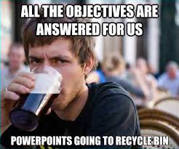
Objectives
Find Patterns
Predict customer acceptance of Credit Card offers
Factors contributing to a Yes or NO

Slide 4
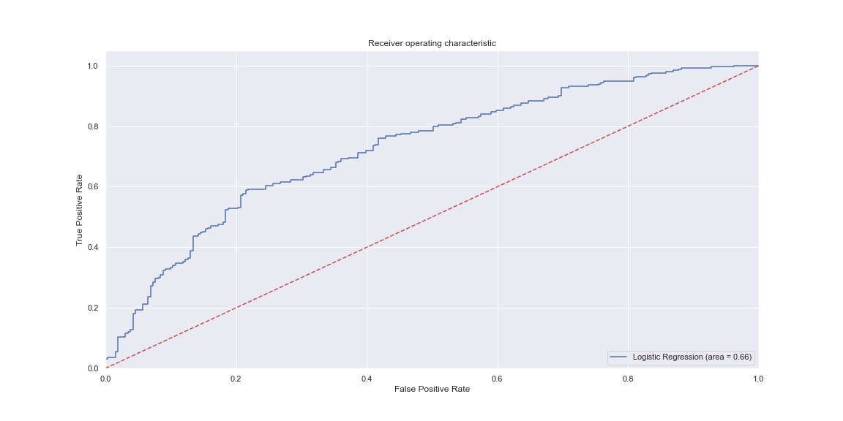
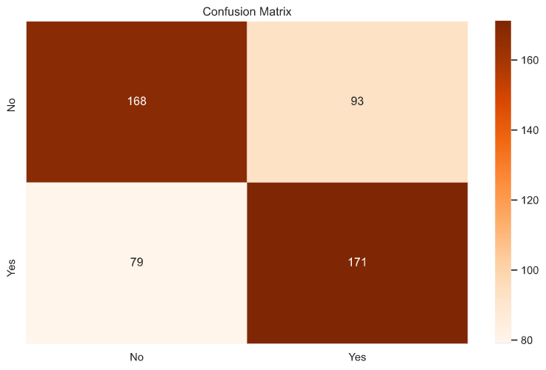
Machine Learning Model
Accuracy: ≈70%

Slide 5

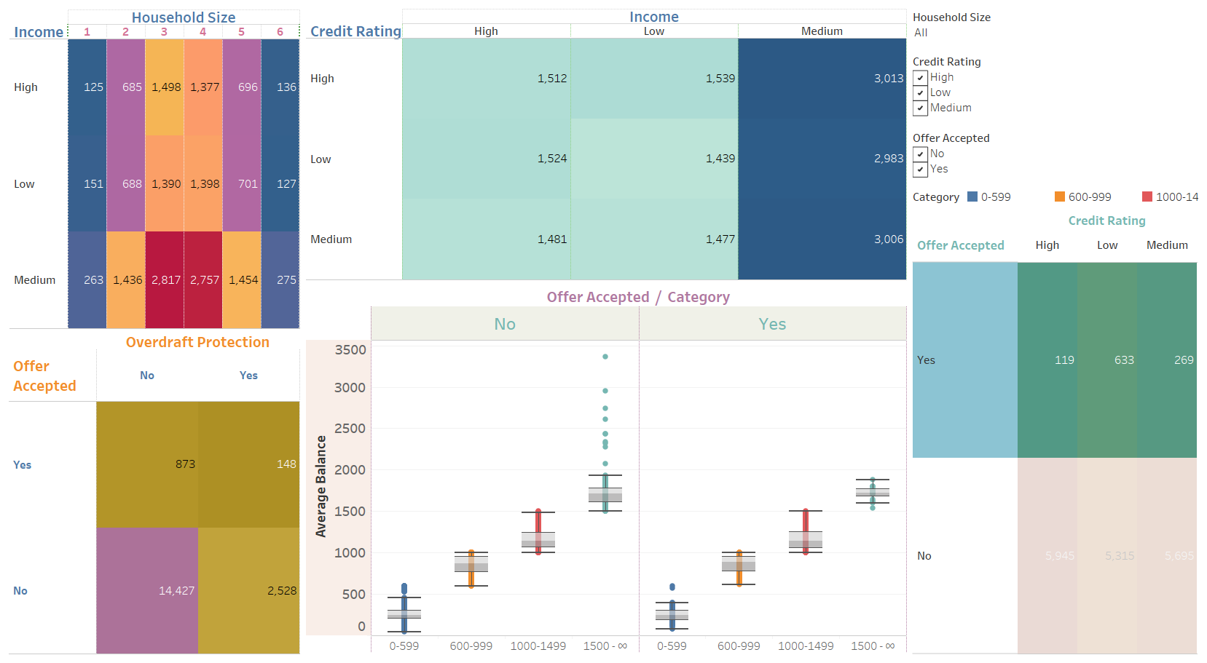
Key Observations

Slide 6

Retrospect

Slide 7
Thank You.
ML
ARASAN MJ
MACHINE LEARNING
+49 1521 8003975
arasanmj@live.com
https://www.linkedin.com/in/arasanmj/

